Slide 1
GoDaddy
Hedging
What we do and how we do it in 2000 slides or less
November 2017

Slide 2
Our vision is to radically shift the global economy toward life-fulfilling independent ventures.
Our mission is to help our customers kick ass by giving them the tools, insights and the people to transform their ideas and personal initiative into success, however they measure it.
Andrea & Brad Danielson Brewhemia
Cedar Rapids, IA USA

Slide 3
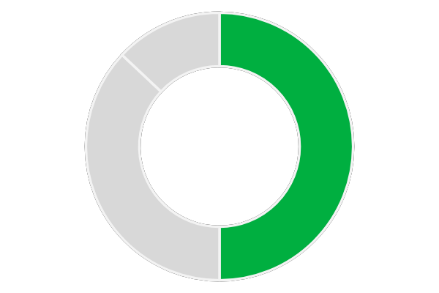
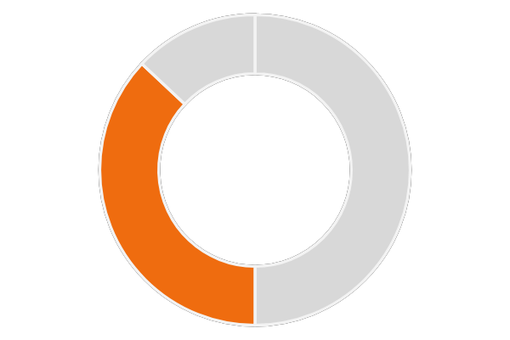
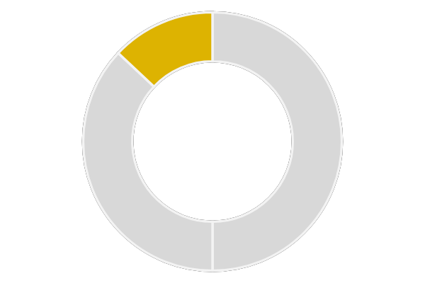
What We Do
Domains
Get a great name.
Hosting & Presence
Bring your name to life.
Business Applications
Grow your business.
$928M
$679M
$241M
50%
of revenue
37%
of revenue
13%
of revenue
10% increase over 2015.
15% increase over 2015.
38% increase over 2015.
All built on a global, high-performance infrastructure and wrapped in world-class customer care.
Unless otherwise noted, all numbers are as of December 31, 2016.

Slide 4
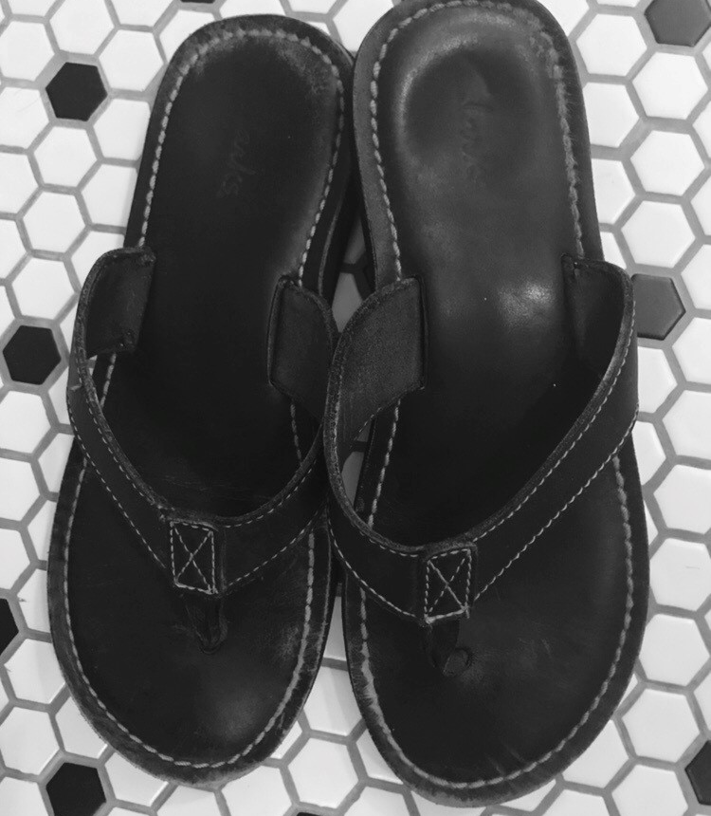
Just get the job done.
Jeremy Beadle on Unsplash

Slide 5
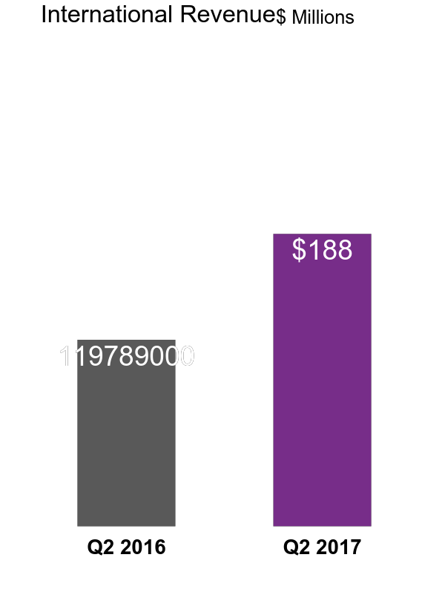
Bold Expansion Globally
50+ Markets and 100+ Countries
57% Growth
YoY growth 61% measured in constant currency.
Unless otherwise noted, all numbers are as of June 30, 2017.

Slide 6
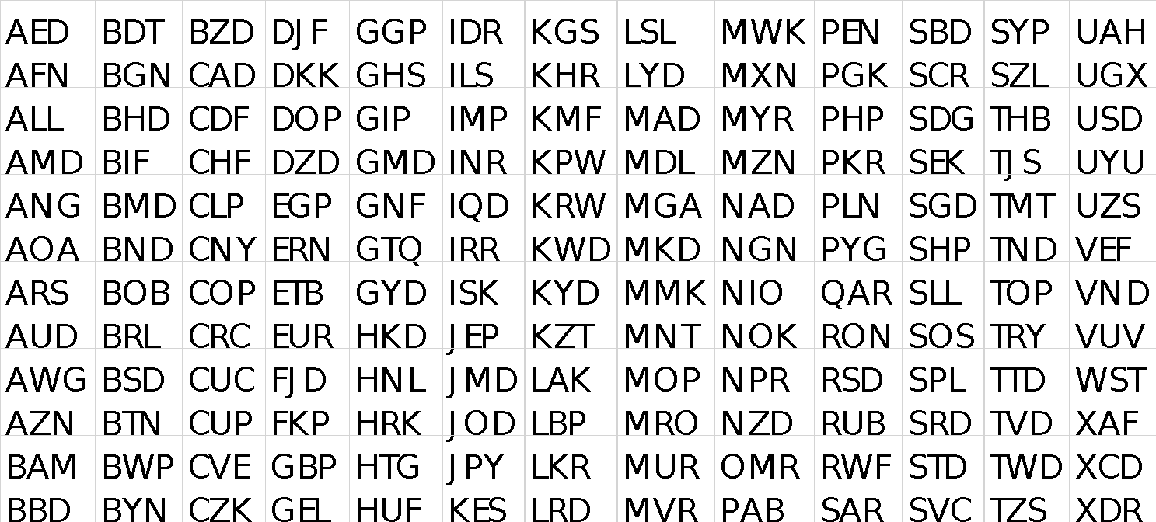
Quantifying the Exposure

Slide 7
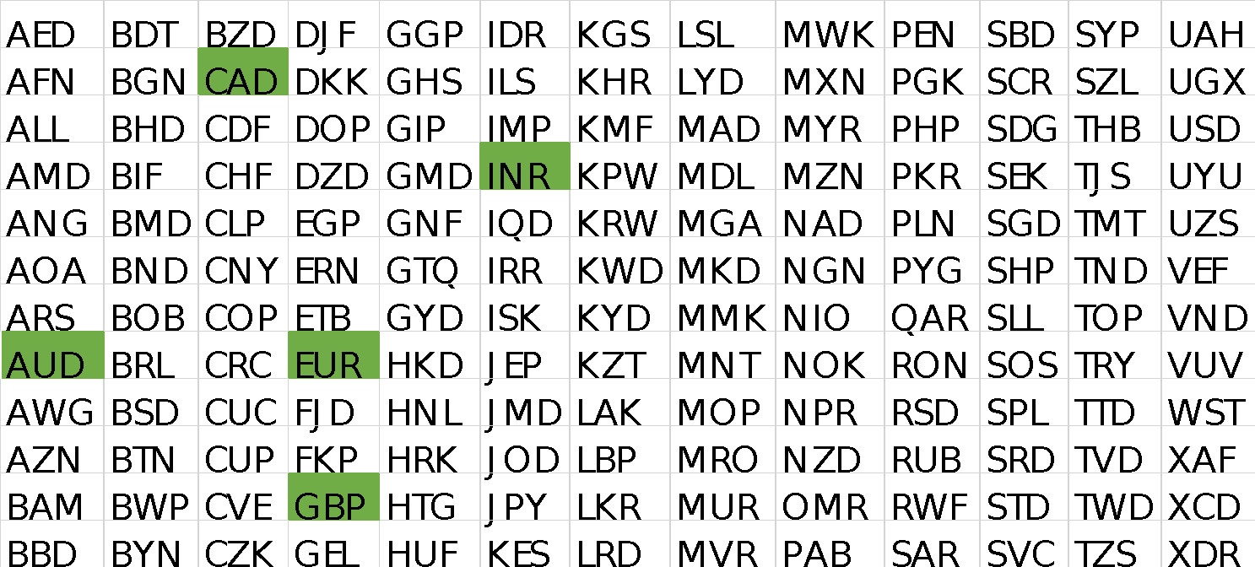
Quantifying the Exposure

Slide 8
Value at Risk & Bang for your Buck
Marginal VaR divided by hedge cost

Slide 9
Timing the Maturity

Slide 10
Vanilla vs. Average
Ilya Llukhin on Unsplash

Slide 11
The Sell: Management & Auditors

Slide 12
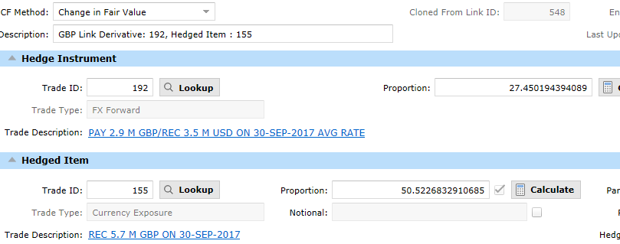
We Have the Technology

Slide 13
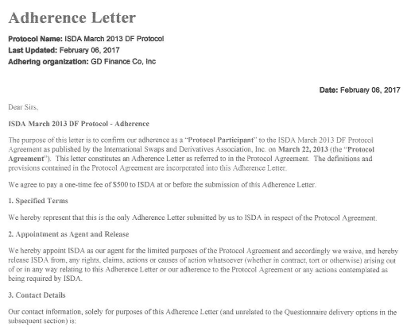
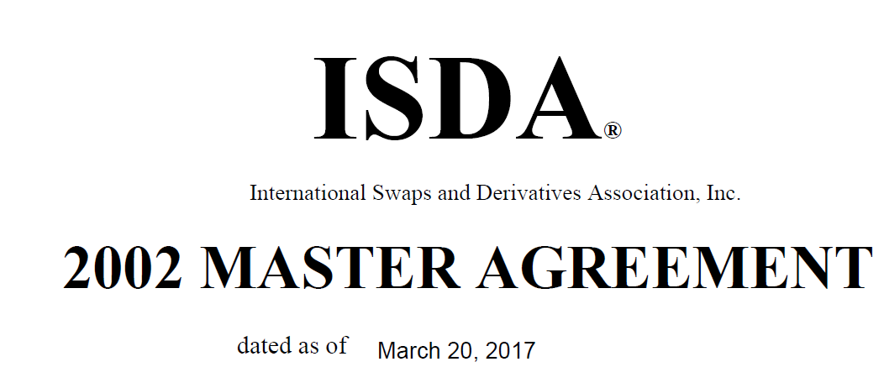
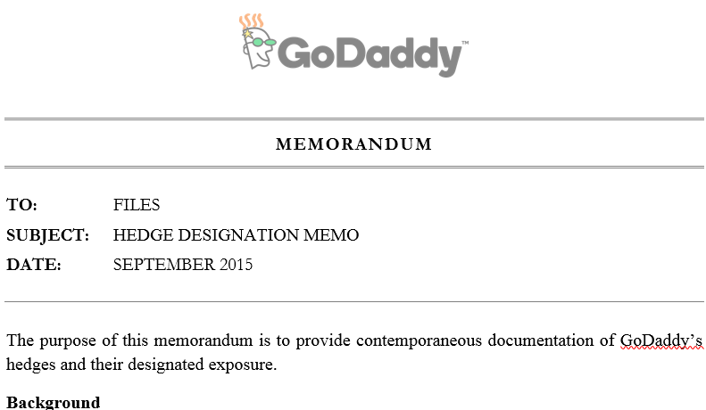
Earning a Degree in Documentation

Slide 14
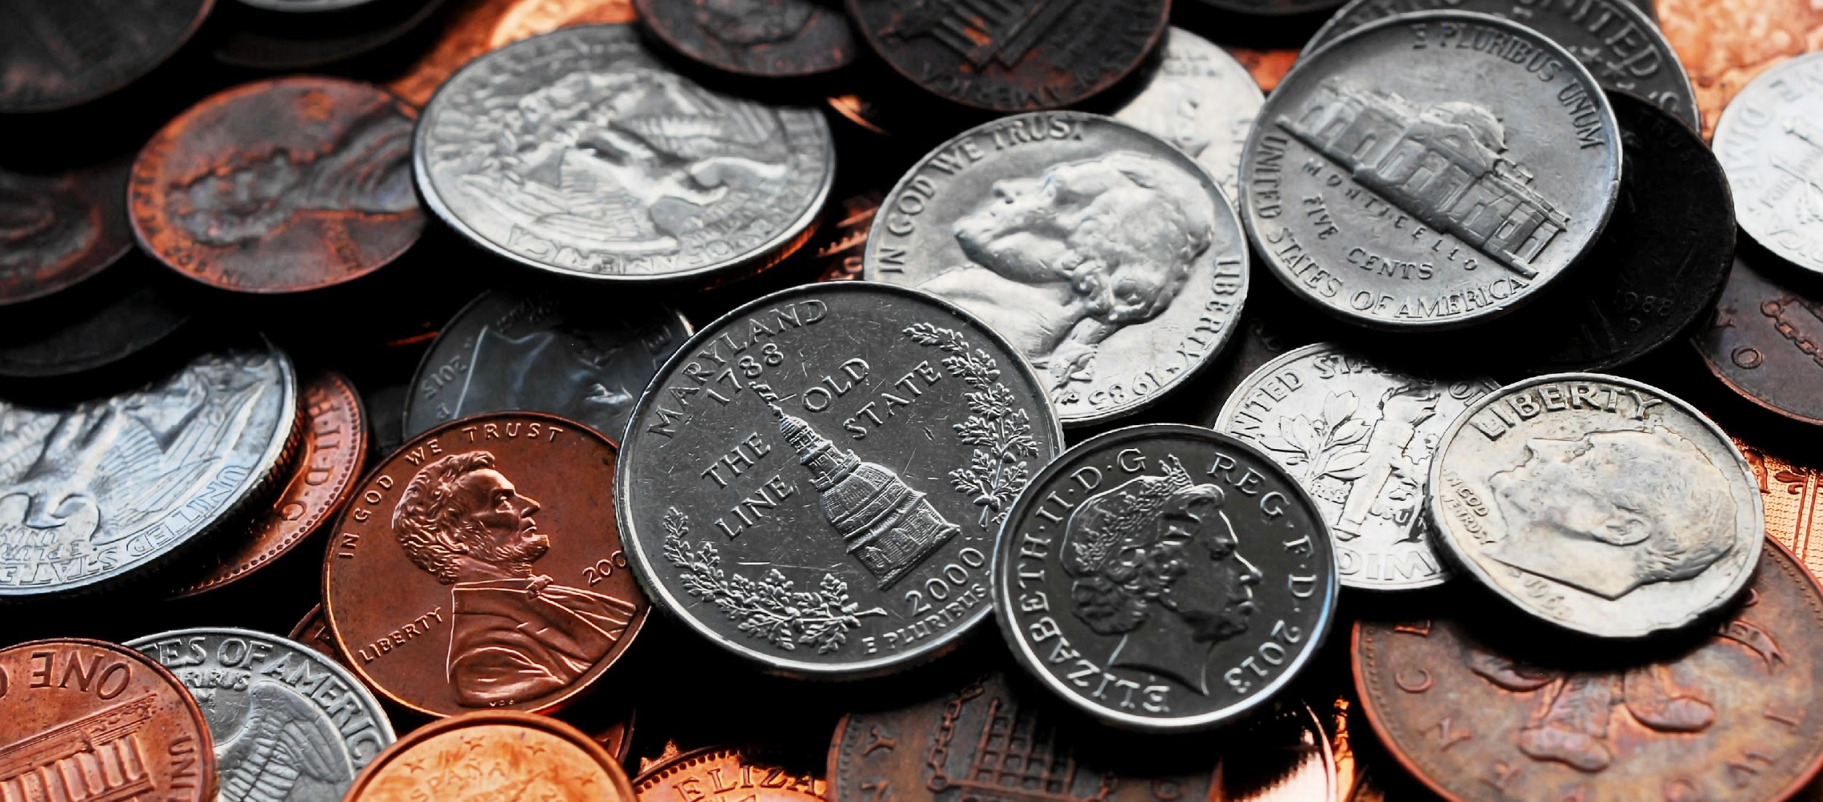
The Trade

Slide 15
The Aftermath: Accounting & Reporting

Slide 16
Acquisition

Slide 17
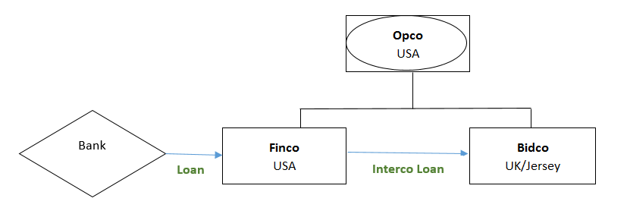
Acquisition Funding

Slide 18
Acquisition Exposure

Slide 19
Acquisition Exposure
Exposure

Slide 20
Swap

Slide 21
Swap
Swap EUR Fixed to USD Floating

Slide 22
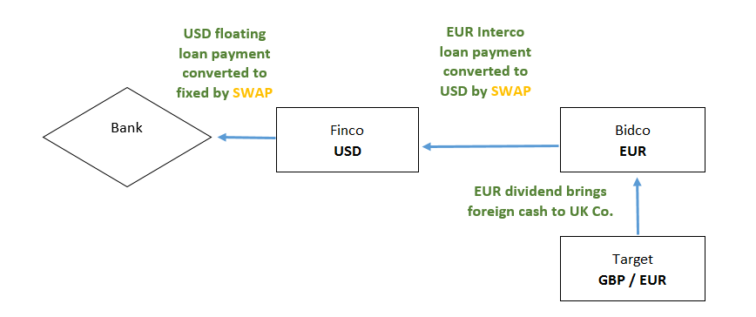
Cash Flows

Slide 23
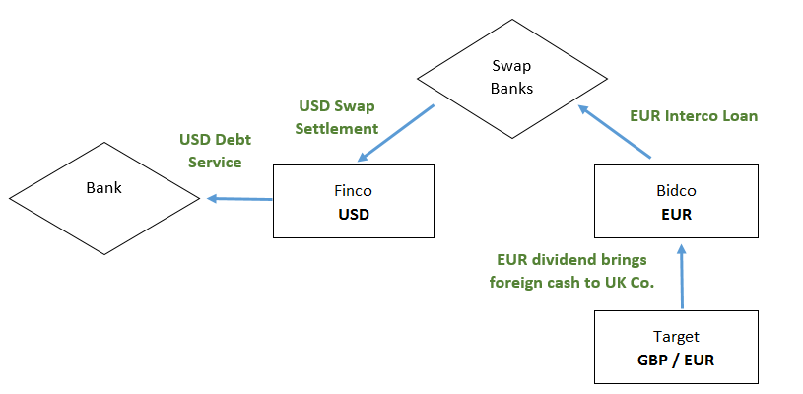
Cash Flows

Slide 24
Vanilla vs. Swaps
Swap market liquidity cap 5 years
We settle the currency swap gross—cash actually flows for both legs
We settle the IR swap net, but combine it with the USD part of the currency swap
There is a significant credit charge (~50bps). Where you put this on the swap matters economically and for auditors
Our notional was so large, we had to syndicate it to 6 banks.

Slide 25
Twitter: @ErinFinanceNerd
LinkedIn: Erin O’Shea
2017
© GoDaddy Inc.

