Slide 1
Cyber Tabletop Exercise Mid-Atlantic Association for Financial Professionals
Presenter: Dara Silverman
September 23rd, 2020

Slide 2
Disclaimer
This presentation was prepared exclusively for the benefit and use of one or more JPMorgan clients to whom it was directly addressed and delivered. The content is intended for informational purposes and is not intended to be used to evaluate any product or service provided by JPMorgan nor intended to be relied on for any related purpose. The statements made in this presentation are confidential and proprietary to JPMorgan and not intended to be legally binding.
The presentation is incomplete without reference to, and should be viewed solely in conjunction with, the oral briefing provided by JPMorgan. It may not be copied, published or used, in whole or in part, for any purpose other an as expressly authorized by JPMorgan. Neither JPMorgan nor any of its directors, officers, employees, or agents shall incur any responsibility or liability to any recipient(s) of this presentation or any other party with respect to its content.
© 2020 JPMorgan Chase & Co. All Rights Reserved.

Slide 3
Agenda
5 Mins
Tabletop Exercise Introduction – Guidelines/Instructions
15 Mins
Module 1 – Scenario Brief and Polling Discussion
15 Mins
Module 2 – Scenario Brief and Polling Discussion
15 Mins
Module 3 – Scenario Brief and Polling Discussion
10 Mins
Hotwash/Lessons Learned/Q&A

Slide 4
Tabletop Exercise Overview
This tabletop exercise consists of realistic scenarios based on current threats and historical examples of actual cyber crises – it is not based upon any intelligence indicating a specific threat to your organization
This type of incident has resulted in legal & regulatory action, media attention, and financial loss
The exercise is designed to emphasize and examine roles & responsibilities as well as key decisions that organizations must make during a cyber event
Key Objectives
Highlight and develop the skills to lead and work through a cyber incident
Understand all relevant stakeholders required to respond to a significant breach
Learn how to conduct an exercise that could be used to test your agency’s breach preparedness
Take away ideas for how your company could improve its incident response plan

Slide 5
Tabletop Exercise Overview
ABC Group
You work for a fictitious organization, ABC Group, a mid-size consulting firm responsible for financial planning and payment processing for public and private organizations in the United States
This exercise will take place over the month of September (notionally). New facts will be provided each day as the investigation unfolds
At the end of each module/day, each participant will be asked to answer polling questions using Slido (www.Slido.com; #4895)
Polling responses will then be discussed amongst the larger group

Slide 6
Tabletop Exercise Overview
Based on recent credible threat intelligence, the Department of Homeland Security (DHS) and FBI post the following Cyber Alert on their websites:
Cyber Alert: Email Phishing Campaigns Targeting Financial Organizations
Date: Monday, September 14, 2020
Over the last few months, DHS and FBI have received reporting from financial institutions and consulting firms regarding a growing phishing email campaign. The phishing emails have a Human Resources theme and either ask the user to update personal information or confirm that a change has been made to their information by clicking on a link. Once clicked, the email downloads a variant of the Ryuk malware that can steal or encrypt critical files and systems. A variation of this campaign has also been observed, where organizations have received Business Email Compromise (BEC) emails from trusted vendors requesting that their financial institution information be updated for an urgent payment.
Recommendations: DHS and FBI recommend the following general best practices, to limit the effect of phishing emails and scams on your organization: 1. Remind users not to open suspicious emails or attachments, or follow suspicious links, as they may contain malware 2. Implement filters at the email gateway to filter out emails with known phishing indicators, such as known malicious subject lines, and block suspicious IP addresses at the firewall.
9:00AM

Slide 7
Module 1
Scenario Brief and Polling Discussion
Monday, September 14, 2020

Slide 8
Monday, September 14, 2020
A new vendor contacts Betty Stevens, a member of the Payments Department at ABC Group, stating that they have not received an expected $55,000 payment for their order of cleaning and sanitation supplies. The vendor asks for the payment to be sent immediately using the updated banking information in the email below
Betty validates that The Clean Company has been contracted to provide regular office sanitation and cleaning supplies, and releases the payment without issue
From: Bill.Jones@Thecleeanco.com
To: Betty.Stevens@ABCGroup.com
Sent: Monday, September 14, 10:00am ET
Subject: Urgent – New Banking Information
Hi Betty,
We are working on your upcoming supply order and cannot move forward with shipping until we receive payment. I don’t want to raise this issue with Milan. Please send your payment to the updated account:
Amount: $55,000
Routing Number: XYZ12345
Account: 39764578
Do not hesitate to call me at 555-234-8657 if you have any questions.
Regards,
Bill Jones
CEO, The Clean Company
Phone: 555-234-8657
10:00AM

Slide 9
Monday, September 14, 2020
Several employees at ABC Group report receiving the following email. The email claims to be from Human Resources and states that the employee’s direct deposit information has been updated
Sent: Monday 09/14/2020 12:00 PM
12:00PM
Human Resources
A120F

Slide 10
Phishing Awareness
Warning signs
Sender name is vague and generic
Sender address has a suspicious domain (i.e. securebankinggroup.org)
Subject does not specify the purpose of the email
Multiple grammar and spelling mistakes including: You’re and Personel
Uses urgent or authoritative language demanding a quick response
The signature block does not contain contact information
The footer contains unusual characters or links
1
2
Sent: Monday 09/14/2020 12:00 PM
3
4
5
6
Human Resources
A120F
7

Slide 11
Monday, September 14, 2020
In reference to the suspicious email, the IT and HR Departments at ABC Group are receiving numerous emails and phone calls from concerned employees stating that they did not make any recent changes to their direct deposit accounts
The IT Department does a preliminary investigation and determines that two employees clicked on the links in the suspicious email. They also discover that:
After analysing systems, IT can see suspicious traffic coming from several internal company machines communicating with an unknown, external Eastern European IP address; further investigation is required to determine additional details
1:00PM
Employees are complaining to the IT Help Desk about increased network latency – internal web pages and applications are taking a long time to load properly

Slide 12
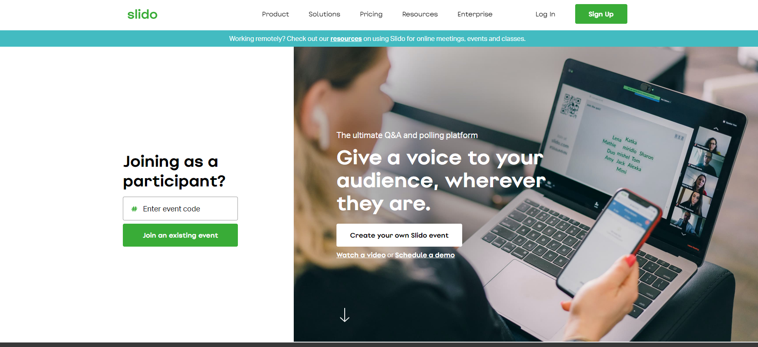
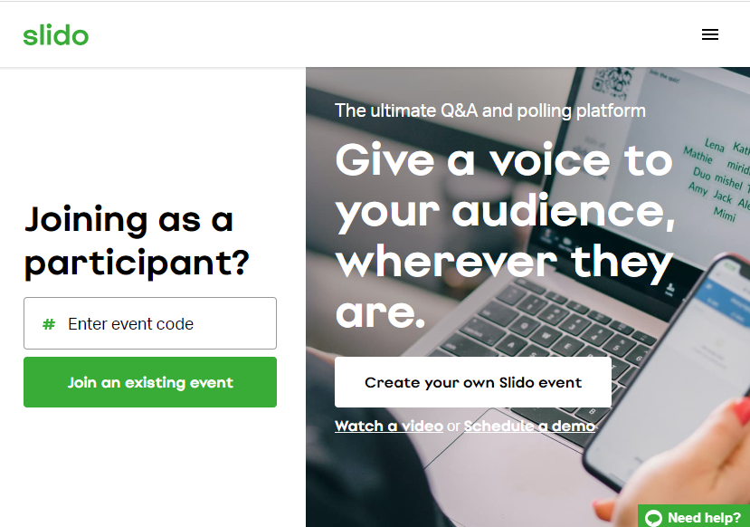
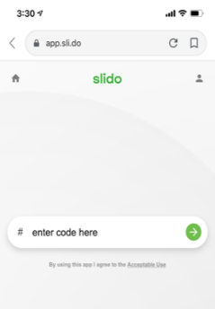
Join and Participate during the Live Polling Questions
www.Slido.com
Event ID #4895

Slide 13
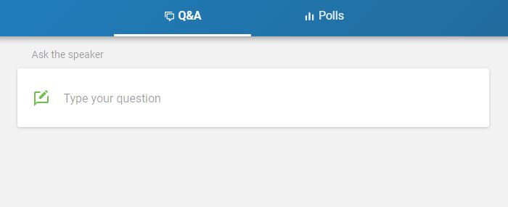
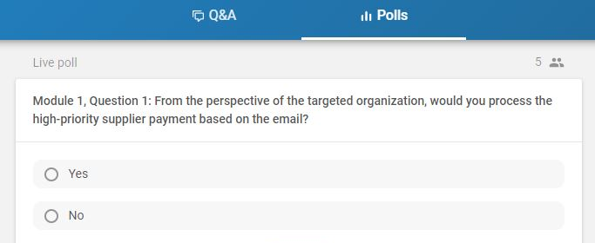
How to Submit Polls and Questions
Once logged into the event, users can toggle between two tabs on Slido:
Q&A: can be used to ask questions, chat with participants, and share best practices
Polls: when the moderator activates a poll, users can switch to the poll tab to select their response
1
2

Slide 14
Polling Questions
From the perspective of ABC Group….
1
Would you process the high-priority supplier payment based on the email?
Y
N
At this time, would you bring in an outside forensics team to help investigate the specific network activity?
Y
N
2
At this time, would you report the phishing emails and suspicious network traffic to the Chief Information Security Officer?
Y
N
3
Join Polling at: www.Slido.com, #4895

Slide 15
Polling Questions
From the perspective of your own organization….
4
Do you receive regular threat intelligence alerts similar to the one in this scenario?
Yes
No
I don’t know
A
B
C
Join Polling at: www.Slido.com, #4895

Slide 16
Polling Questions
From the perspective of your own organization….
If you answered “yes” to the previous question (#4), what are the primary sources from which you receive threat intelligence? Select all that apply:
5
My own research in the news and/or from friends and family
Federal government agencies
State and local agencies
Industry partnerships (e.g. ISACs)
Other
Does not apply/selected “no” to the previous question
A
B
C
D
E
F
Join Polling at: www.Slido.com, #4895

Slide 17
Polling Questions
From the perspective of your own organization….
Does your organization have a formal playbook/plan that addresses how to respond to potential cybersecurity incidents?
6
Yes
No
I don’t know
A
B
C
Join Polling at: www.Slido.com, #4895

Slide 18
Polling Questions
From the perspective of your own organization….
If you answered yes to the previous question (#6), do you provide annual employee training based on that playbook/plan?
7
Yes
No
I don’t know
Does not apply/selected “no” to the previous question
A
B
C
D
Join Polling at: www.Slido.com, #4895

Slide 19
End of Module 1
Results and Discussion

Slide 20
Module 2
Scenario Brief and Polling Discussion
Monday, September 21, 2020

Slide 21
Monday, September 21, 2020
The Clean Company calls ABC Group and notes they should be receiving a new invoice soon for a required payment related to their upcoming re-stock of cleaning supplies
The ABC Group employee notes in their records that a payment of $55,000 was just made to The Clean Company last Monday at 10:30 AM. The Clean Company states that they did not receive any funds and verifies the account number to help locate the payment
The ABC Group employee researches the payment and determines it was sent to a different, incorrect account number. The issue is escalated to management as fraud to see if the payment can be reversed
1:00PM

Slide 22
Monday, September 21, 2020
2:30PM
Employees at ABC Group appear to be locked out of multiple systems that contain critical data and they receive the following pop up message
HACKED!
Hello ABCers,
Surprise! We’ve encrypted your critical files and systems. You have 48 hours to pay us $40K USD in Bitcoin. If you pay, we will send you the decryption key to get your files back. If you don’t meet our timeline, your data will be lost forever.
Follow the link for payment instructions.
Regards,
Kobra
!

Slide 23
Monday, September 21, 2020
3:30PM
The IT Team at ABC Group recommends a rebuild of data applications using virtual tape backups on existing hardware
The last known good data is 4 days old and does not include critical data and information
ABC Group has never had to restore from the backup, and IT estimates it could take between 12-72 hours

Slide 24
Monday, September 21, 2020
4:30PM
A major media outlet contacts ABC Group claiming to have received details of a serious cyber attack from an anonymous source
The news outlet is going to release the story and is asking for comment from ABC Group on what is happening and what they are doing in response

Slide 25
Polling Questions
From the perspective of ABC Group….
1
Should you pay the $55k ransom to get critical files & system access back?
Y
N
2
Should you contact law enforcement for assistance at this time?
Y
N
3
Should you make a public statement at this time about the ongoing incident?
Y
N
Join Polling at: www.Slido.com, #4895

Slide 26
Polling Questions
From the perspective of your own organization….
4
Why do you think the adversary is asking for payment in Bitcoin? Select all that apply:
It is easier than PayPal to send large sums
It can help hide the attacker’s identity
It is less volatile than traditional money
There are fewer regulations regarding cryptocurrency
All of the above
A
B
C
D
E
Join Polling at: www.Slido.com, #4895

Slide 27
Polling Questions
From the perspective of your own organization….
5
What type of financial controls do you have to identify and prevent fraudulent payments? Select all that apply:
End of day reconciliation
Limiting “toxic pairs/combinations”
Secondary approvers or higher level review before processing payments
Positive pay/reverse positive pay
Behavioral analytics
A
B
C
D
E
Join Polling at: www.Slido.com, #4895

Slide 28
Polling Questions
From the perspective of your own organization….
6
Does your organization have a standalone Cyber Insurance policy?
Yes
No
I don’t know
A
B
C
Join Polling at: www.Slido.com, #4895

Slide 29
End of Module 2
Results and Discussion

Slide 30
Module 3
Scenario Brief and Polling Discussion
Tuesday, September 22, 2020

Slide 31
Tuesday, September 22, 2020
8:30AM
An anti-western cyber criminal group called Kobra takes responsibility for the cyber attack and claims that sensitive and/or confidential data from ABC Group have been posted to the “Dark Web”

Slide 32
Tuesday, September 22, 2020
9:15AM
News of the hack has been shared on media channels and industry sharing groups
Additional vendors and key stakeholders are reaching out to determine if they are at risk
Attempts to recall the fraudulent $55k payment are unsuccessful

Slide 33
Polling Questions
From the perspective of ABC Group….
1
Should the CEO/President of ABC Group make a public statement at this time?
Y
N
Should a more detailed message about the incident be sent to key stakeholders/vendors/industry groups about the data breach?
Y
N
2
Would you hire outside legal counsel or engage internal counsel to prepare for possible litigation?
Y
N
3
Join Polling at: www.Slido.com, #4895

Slide 34
Polling Questions
From the perspective of your own organization….
Does your organization have contingency options to issue critical payments manually if your IT systems are down?
4
Yes, we can do it manually through a separate network/system
Yes, we can do it manually from an alternate financial institution
No, we don’t have the ability to issue critical payments manually
I don’t know
A
B
C
D
Join Polling at: www.Slido.com, #4895

Slide 35
Polling Questions
From the perspective of your own organization….
Does your organization have a crisis communications plan that addresses cyber resilience?
5
Yes
No
I don’t know
A
B
C
Join Polling at: www.Slido.com, #4895

Slide 36
Polling Questions
From the perspective of your own organization….
Does your organization communicate with its banking institution(s) around these types of scenarios to prepare/plan effectively?
6
Yes, we have recurring meetings with our banking institution(s)
Yes, and our banking institution(s) offer/provide trainings to help us prepare/plan effectively
No, we do not regularly communicate with our banking institution(s) around these types of scenarios
A
B
C
Join Polling at: www.Slido.com, #4895

Slide 37
End of Module 3
Results and Discussion

Slide 38
Exercise Wrap Up
The data was exfiltrated (i.e., stolen) from an externally-facing web server before the ransomware spread throughout the network
The forensics provider was able to identify a phishing email posing as the Human Resources Department that led to the unauthorized access to the system using valid user credentials
Additionally, forensics determine that the corporate network was infected by a modified strain of the Ryuk ransomware
ABC Group loses a number of key clients

Slide 39
Key Steps to Protecting Your Business
Independent Assessment
Engage an experienced engineering firm that understands the technical risks, complexities of enterprise architecture to do a complete technical independent assessment of your agency’s infrastructure.
Authority Engagement
Establish a clear engagement model with governing authorities, including law enforcement (who are you going to call, which agency and under what circumstances?). Have the relationships established up front.
Join Industry Forum
Join an industry-based information security forum. Understand the latest threats to your industry before they impact your agency.
Attack Yourself
Create an internal team or engage a vendor to attack your systems using the same techniques bad guys do - but all the time, not once a year. Some vendors may also be able to monitor the availability of your credentials to the public on the “dark web.”
Mandatory Employee Training & Testing
Malicious email is the No. 1 way bad guys get into organizations. Establish a mandatory baseline training program for all employees that focuses on the specific actions employees need to take to protect your agency. Once you have trained your employees, actively test them.
Third Parties
Understand your third party environment and upgrade your contract provisions so that third parties are following the same standards you are striving for in your own environments.
Exercise & Drills
Run simulations and drills to assess your capabilities. Use a combination of table top exercises and inject real life scenarios to see how your Security Operations Center responds. Include business and technologists in exercises.
Money Movement
Look at all of the ways money leaves your agency. Figure out what controls and thresholds you can put in place to protect money movement, assuming bad guys get around your other controls.
Protect your Computers
Consider physical or logical network segmentation for funds transfer-related computers; employ the concept of ‘least privilege” to limit the use of administrator accounts; and consider limiting the processes & services that can be run on funds transfer computers (email & web).
Take our Training
99% of the wire fraud we are seeing with JPMC’s institutional clients is associated with companies who have NOT taken our Cyber Fraud & Secure Online Banking webinar.

Slide 40
Q&A

Slide 41
Helpful Links
Ransomware Groups Continue to Target Healthcare, Critical Services; Here’s How to Reduce Risk
FBI Anticipates Rise in Business Email Compromise Schemes Related to the COVID-19 Pandemic
In the Last 10 Months, 140 Local Governments, Police Stations and Hospitals Have Been Held Hostage By Ransomware Attacks
V is for Vendor: The Emergence of Vendor Email Compromise
The State of Ransomware in the US: Report and Statistics 2019
Cyber Hero Mario Garcia Keeps California Safe, Builds Cybersecurity Workforce
Ransomware Attacks: Building An Effective Disaster Recovery Plan
How To Survive A Ransomware Attack -- And Not Get Hit Again
How To Protect Your Organization From Ransomware Attacks
Half Of Ransomware Victims Suffer Repeat Attacks
2019 Cost Of A Data Breach Report
Cybersecurity Assessments Offered By The Cybersecurity & Infrastructure Security Agency (CISA)

