Slide 1
The Dawn of a New Era in Electronic Invoicing and Payments
October 17, 2018
Mid-Atlantic Association for Financial Professionals
Baltimore, MD

Slide 2
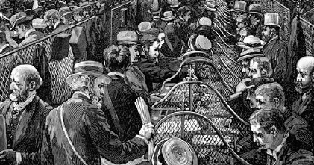
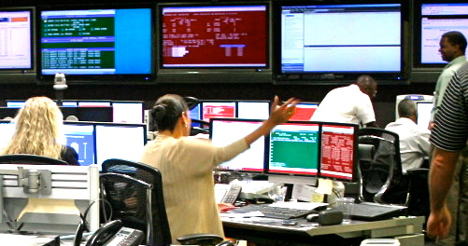

The Clearing House: A Hub for Interbank Exchanges and Innovation
Founded by New York banks to improve efficiency and remove risk from daily exchanges
1853
Owns and operates core U.S. payments system infrastructure, clearing and settling approximately $2 trillion each day, representing half of all commercial ACH, wire and check image exchange volume
TODAY
RIGHT NOW
Working to modernize the U.S. payments infrastructure by building a new, ubiquitous, real-time payment system
©2017 The Clearing House Payments Co. LLC

Slide 3
Real-time payments systems are being implemented around the world
(30 Countries)
(15 Countries)

Slide 4
The B2B Industry also has many key challenges
1
2
3
4
Incomplete
Reconciliation Data
Incomplete or absent information has been noted as a top remittance processing pain point by 43% of corporate treasurers (FRB Electronic Payments & Remittance Data survey). Similar data gaps exist on the payables side as well.
Manual AR / AP
Processing Inefficiencies
  Of the roughly 25 billion invoices generated yearly in the US, about 75% of those are exchanged physically, resulting in costly manual intervention during financial supply chain processes.
Lack of Standardization of
Information Exchange
Inconsistent data formats when processing remittance details have been identified as a major challenge by 40% of corporate treasures; similar challenges persist on the Buyer side.
B2B Market
Fragmentation
Significant B2B ecosystem fragmentation continues to hinder efficiency. Numerous solution providers have captured minimal market share, creating isolated networks.
5
6
7
8
Costly B2B
Solution Options
Existing solutions can be expensive and/or require lengthy implementations to integrate Buyers and Suppliers, leading corporates to continue to rely on checks and lockbox services.
Late Payments due to
Limited Working Capital
  Around 47% of Suppliers report being paid late for products and services primarily due to customer liquidity constraints, according to Atradius Payments Practice Barometer.³
Lack of Visibility into
Financial Supply Chain
A lack of information transparency exists within the Financial Supply Chain, limiting opportunities for both dynamic discounting to be provided to Buyers and for FIs to offer advisory services to their corporate clients.
Limited Receivable
Management reach
Even though instruments such as Checks are still the most common method of Payment (51% of organizations make B2B payments through Checks), adoption of Lockbox services is still significantly low (only 18% for Middle Market).
Problem Statement
The existing B2B solution options available in the market are highly fragmented with poor connectivity between existing networks resulting in limited reach, inefficient processing, costly manual interventions and inability to achieve electronification and straight through processing.

Slide 5
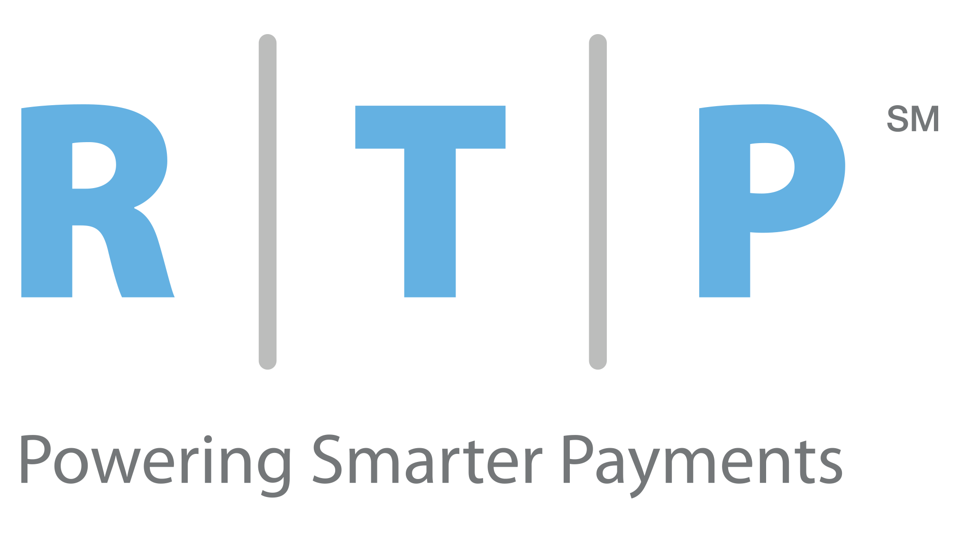
2017 saw the birth of a modern new core payment system in the US

Slide 6
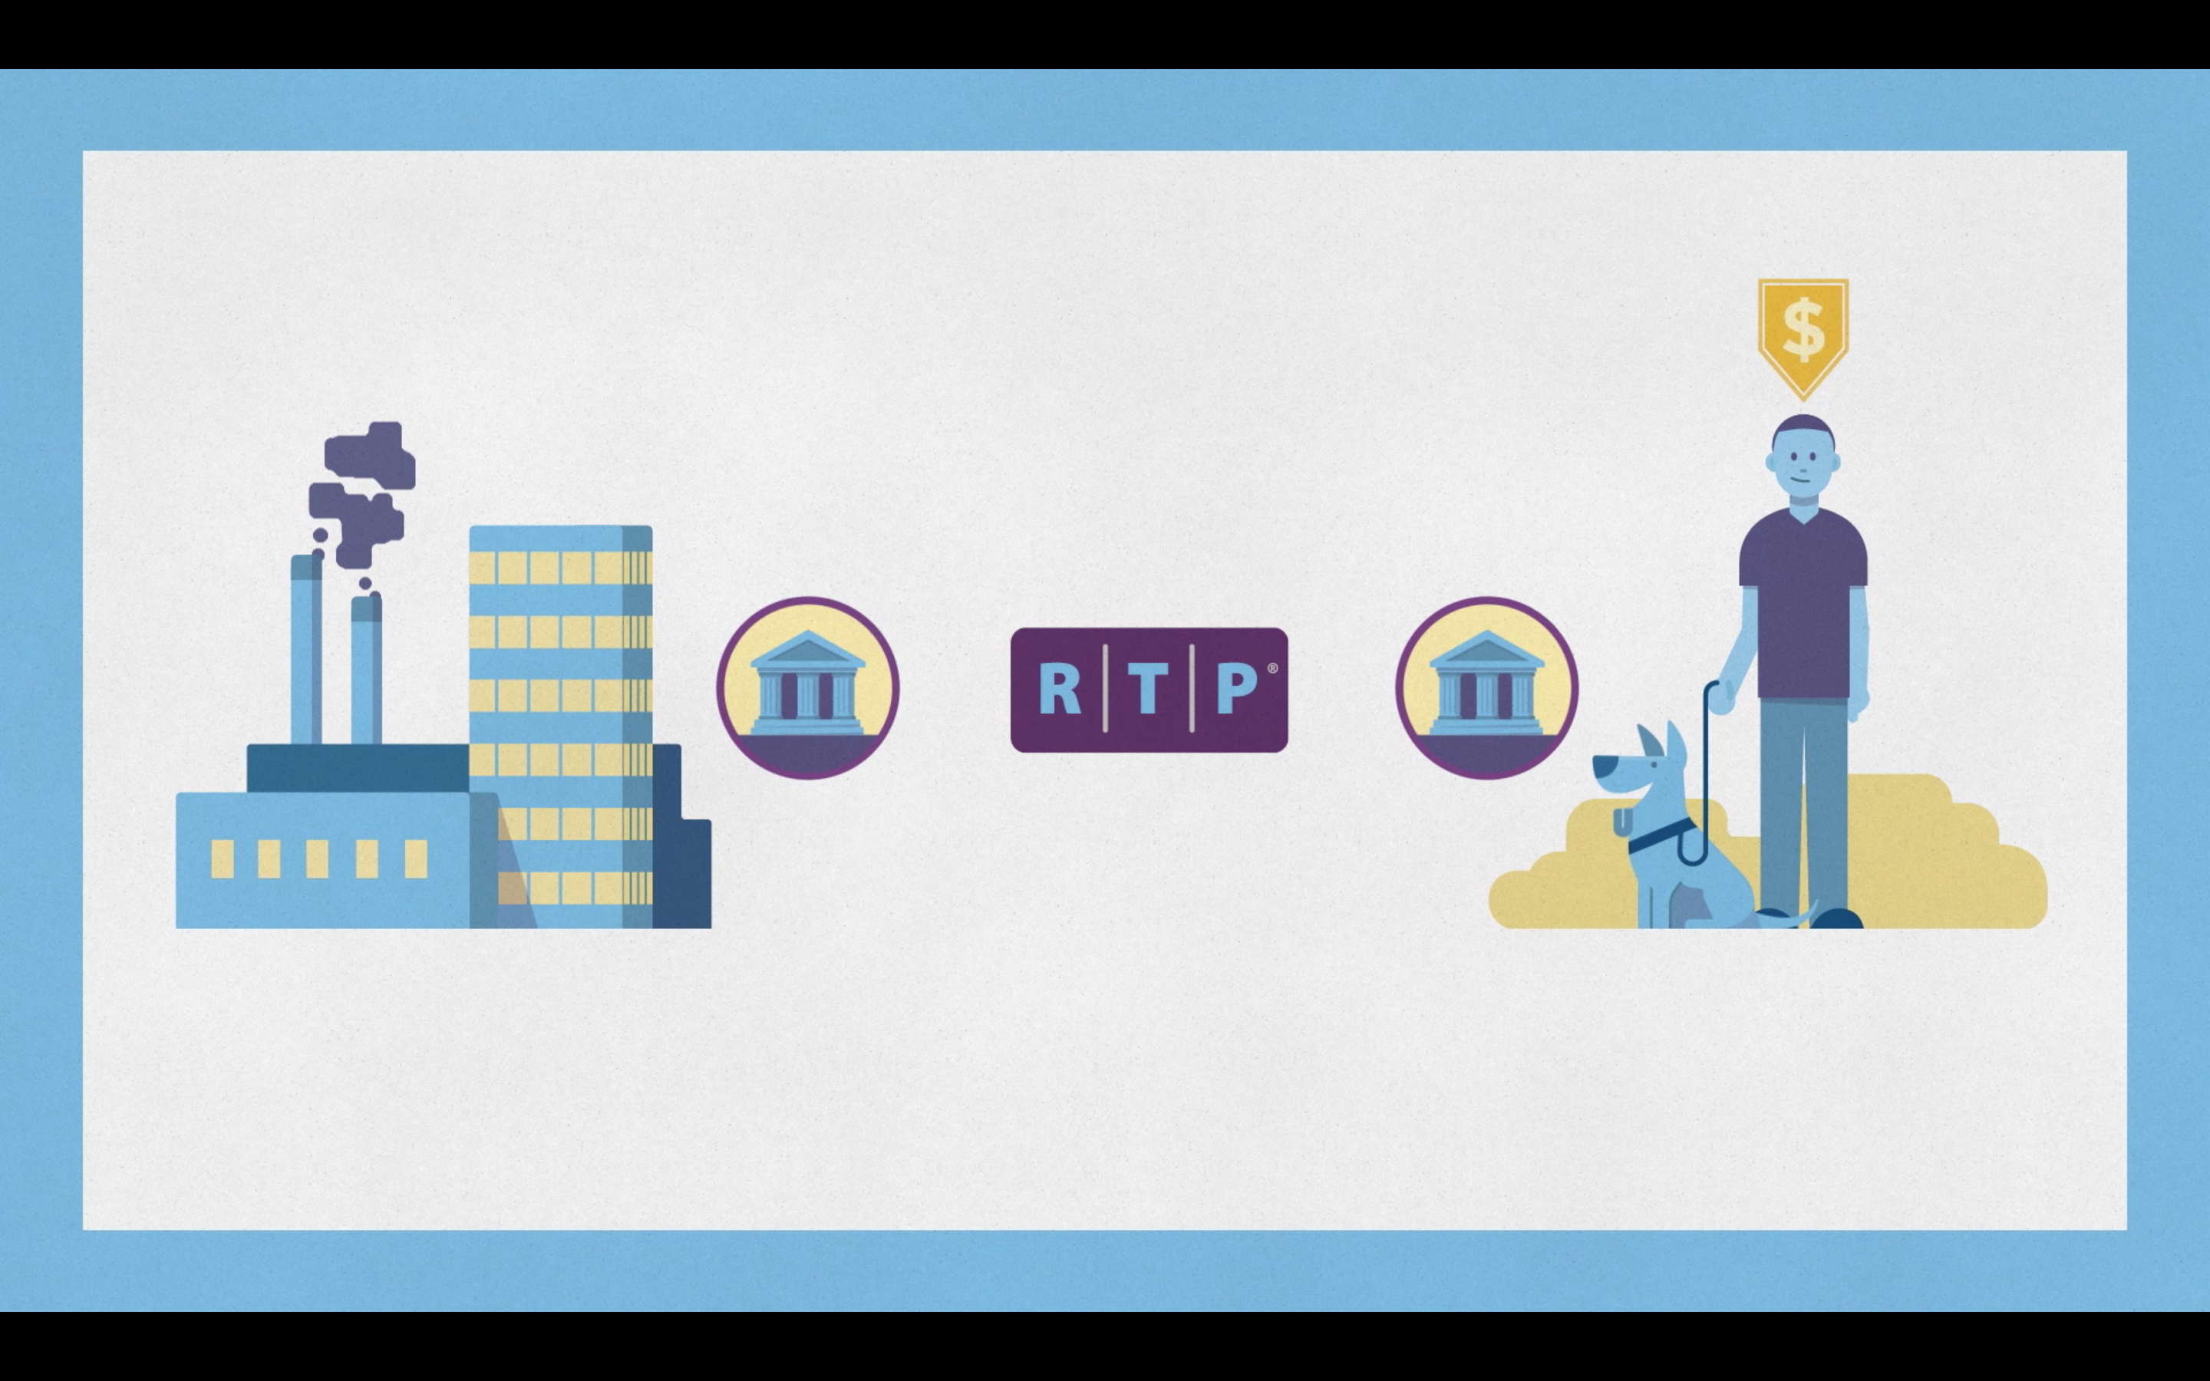
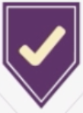








RTP is a brand new payment system designed for the 21st century and beyond

Slide 7








RTP was built to support the growing demand of customers in a real-time market
INITIATION
AUTHORIZATION
MESSAGING
CLEARING
SETTLEMENT
U.S. Payments Systems or “Rails”
Check Image Exchange
Bill Pay /
Individual Payments
ACH
Corporate
Disbursements
Wire
PAYER
PAYER’S FI
PAYEE
PAYEE’S FI
Payroll
B2B Payments

Slide 8

The RTP messages are the building blocks for new products and deeper integration
Credit
Transfer
Request
for
Payment
Receipt
Confirmation
💸
📪
👌
Invoice/
Remittance
Detail
Request
for
Information
Messages are ISO 200022
Assured delivery – all messages are confirmed or rejected immediately
XML format and assured delivery make RTP a good fit for API-based deployment
📰

Slide 9
RTP enables a complete contextual conversation about through out the full payment lifecycle
Company A is owed $2,000
by Company B
Request for Payment
Credit Push
Company B sends $5000 to Company A
Company A doesn’t know what the extra $3,000 was for
Request for Information
Extended Remittance
Company B needs to show they are paying multiple invoices
Company A has applied the payments from Company B
Acknowledgment Message
= Customer Action
= RTP Message

Slide 10
Leveraging Application Programing Interfaces (API’s) makes more sense with RTP
Banking and payments can become more deeply integrated into your processes
RTP Message
Financial Institution Interface
End Customer System
Request for Payment
API Integration to ERP/Payables System
Auto Linking to Purchase Order
Triggers Approval Flow in ERP System
Credit Transfer
API Integration to ERP/Payables System
System Submits Credit Transfer at Scheduled Time
©2017 The Clearing House Payments Co. LLC
TCH CONFIDENTIAL

Slide 11
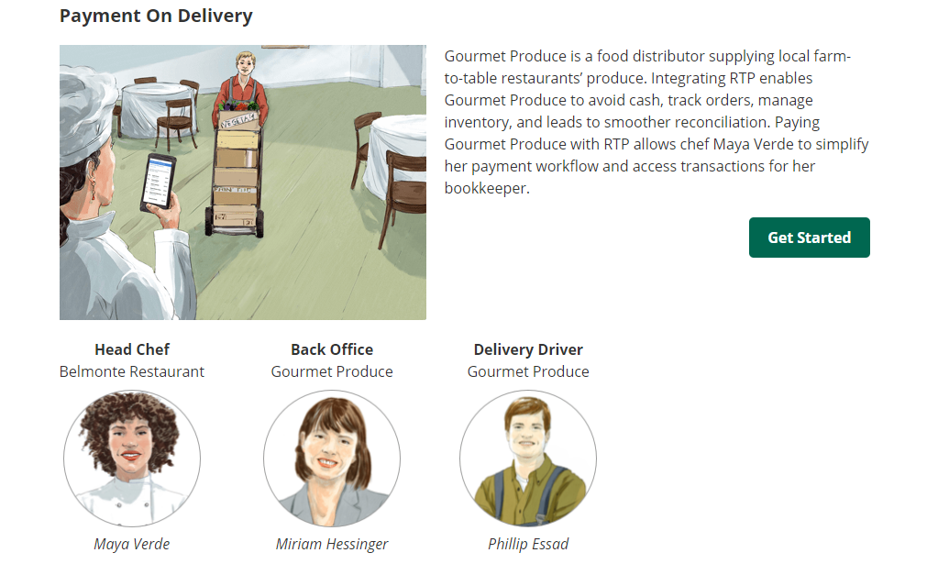

Slide 12
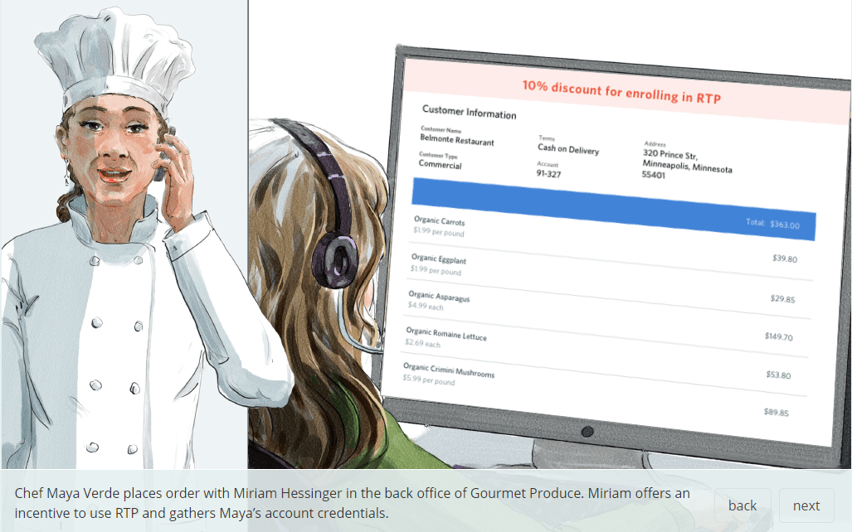

Slide 13
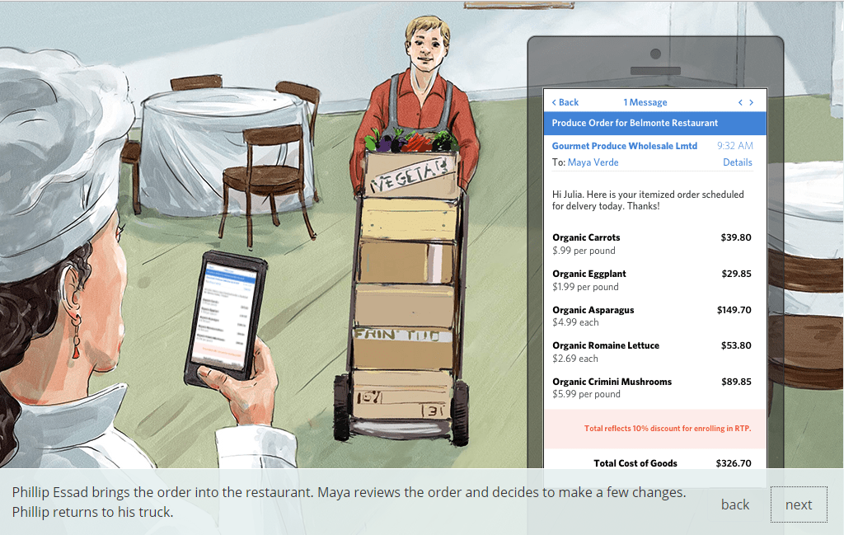

Slide 14
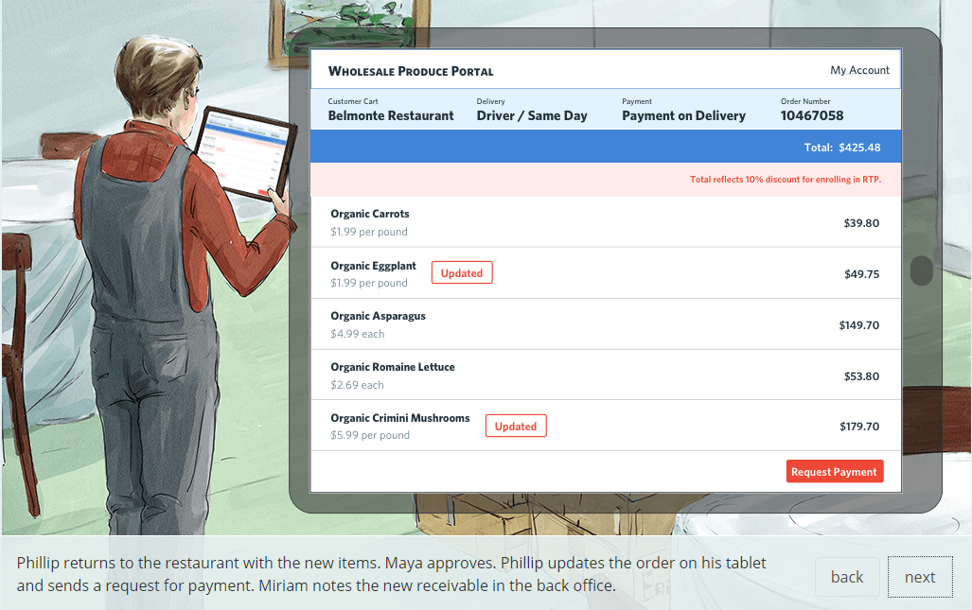

Slide 15
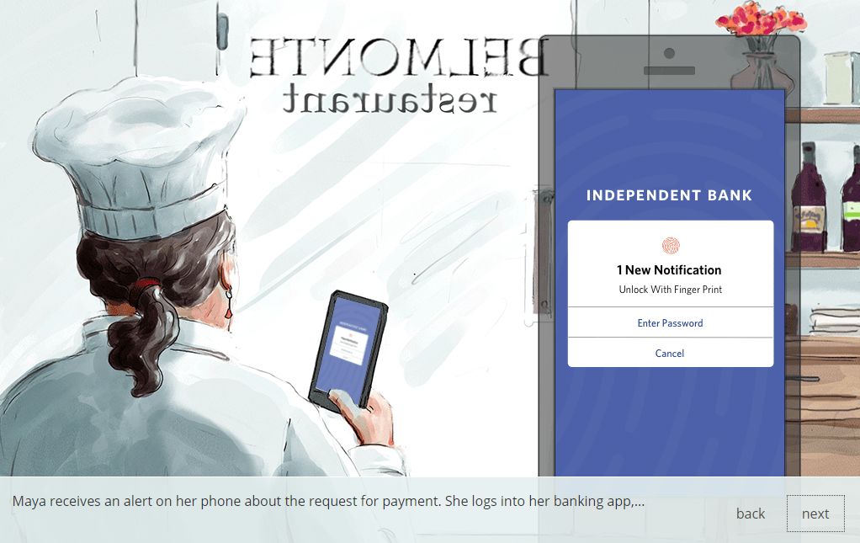

Slide 16
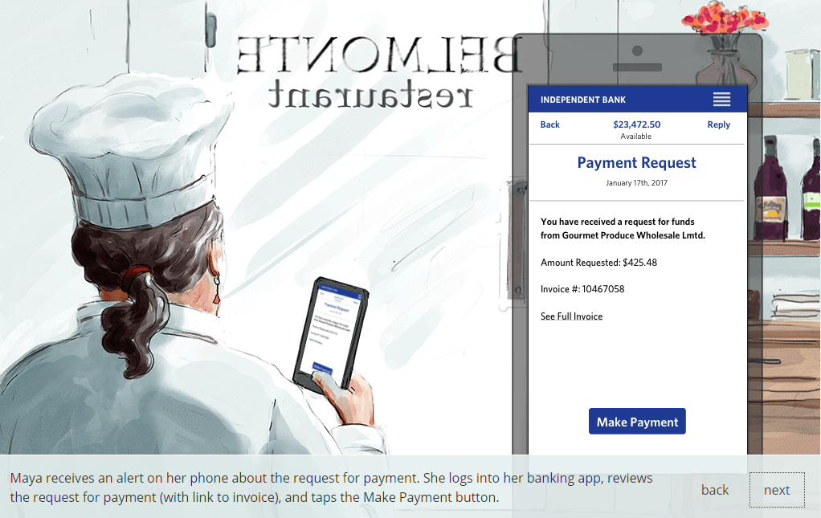

Slide 17
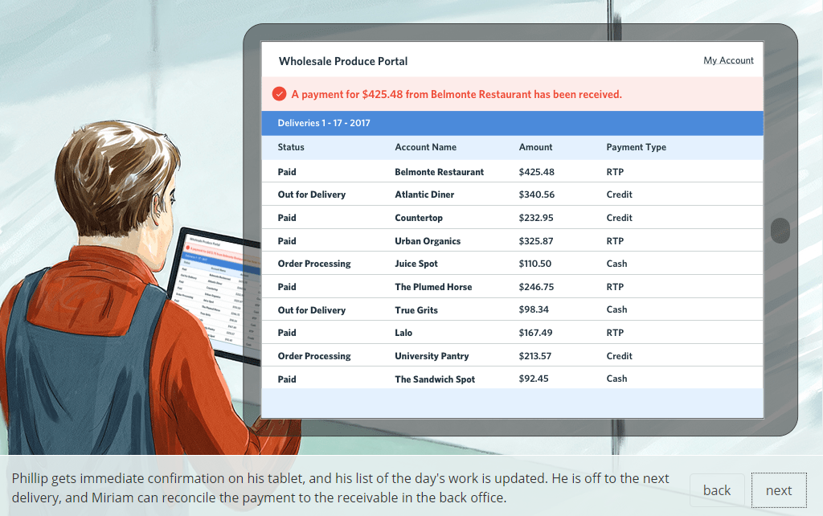

Slide 18
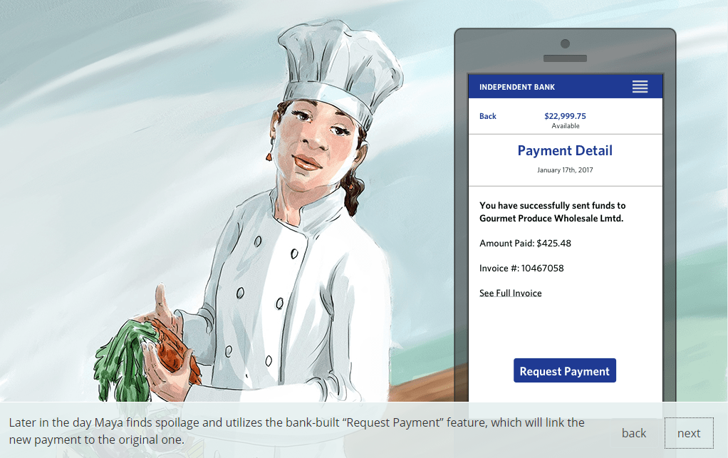

Slide 19
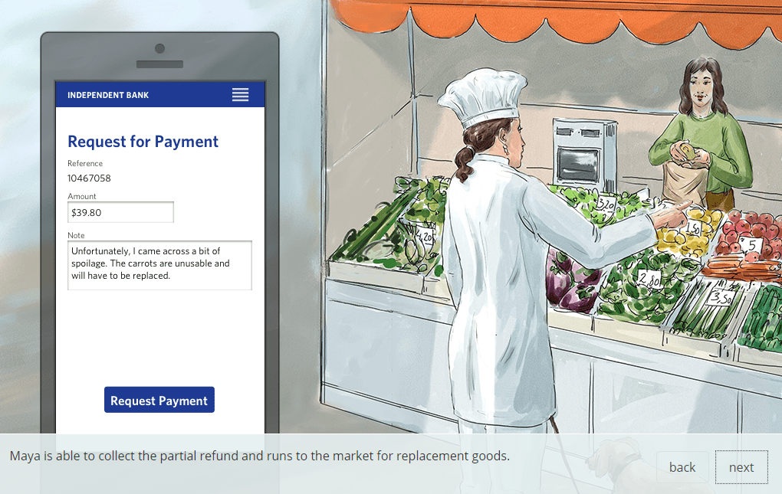

Slide 20
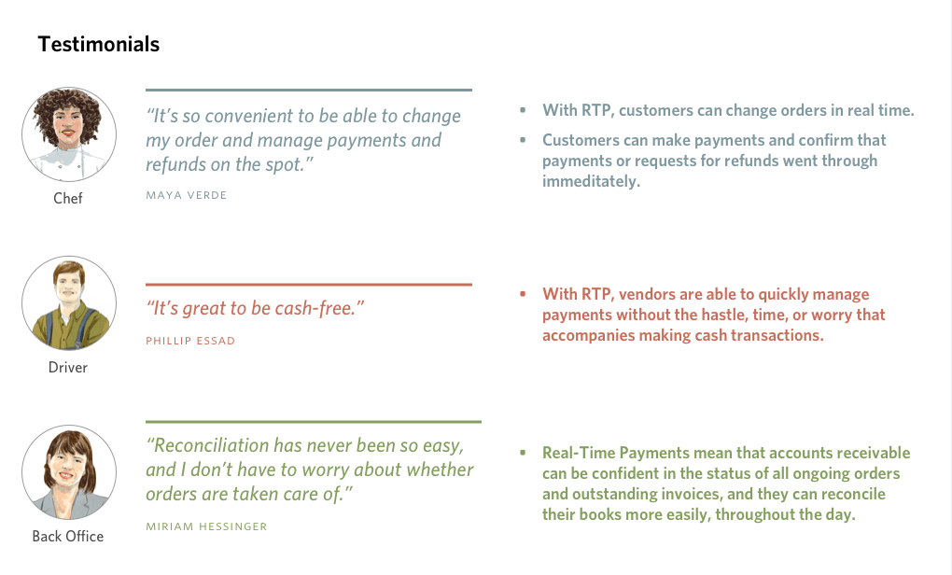

Slide 21



